Slide 2




Disclaimer
Don’t do illegal shit

Slide 3


Reverse Engineering - Overview
Reverse engineering is the process that is taken to understand how a piece of software accomplishes its task.
Reverse engineering is important when hacking as it gives you a greater understanding of how something works making it easier for you to find an exploit within the code as well as figure out how to potentially stop malware such as ransomware.
Common tools used for reverse engineering are Ghidra and IDA freeware

Slide 4
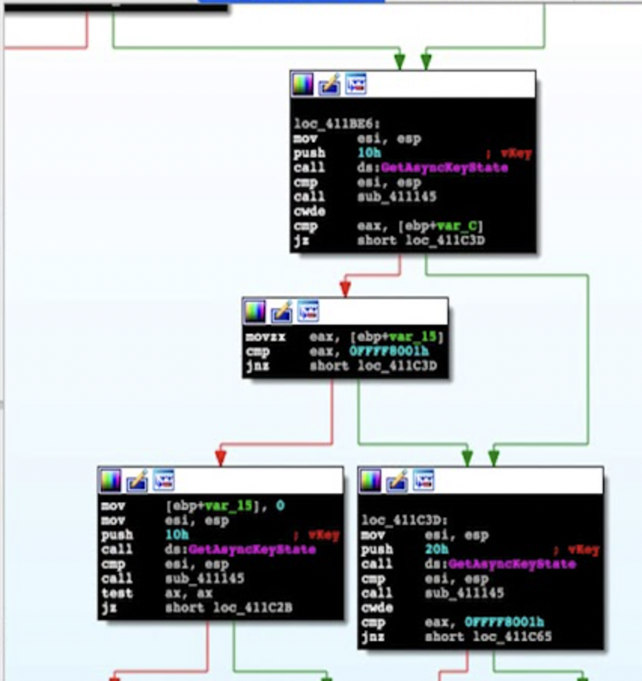
Reverse Engineering - IDA Freeware
IDA Freeware is a free binary analysis tool that decompiles (converts) executable binaries into machine code for you to analyse.
The code is organised into the different functions with visible links for you to understand the program’s flow to better understand how the executable functions.
IDA Freeware is best suited for people that can understand and translate x86/x64 assembly code. There are paid versions of the software that can also convert arm and arm64 binaries.

Slide 5

Reverse Engineering - Ghidra
Ghidra is an open-source software reverse engineering tool developed by the NSA. It can be downloaded from the NSA’s github for free.
Ghidra can reverse engineer an executable into c code which makes it much easier to analyse than assembly code. It also has tools for quick string searching and organises all of the code into functions.

Slide 6
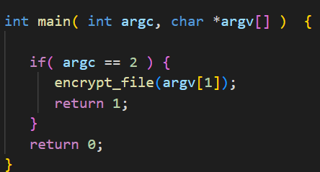

Reverse Engineering - C
When reverse engineering executables ghidra will convert the machine code to c code. This makes it much easier to read than the assembly.
Functions are defined in c with the following syntax:
return_type function_name(param_type parameter){}
All c code starts with a main function that can take two parameters.
argc - How many arguments
argv - An array of arguments
The arguments are passed when executing the program where the name is the first argument and anything after is it’s own argument separated by spaces
./executable arg1 arg2
+, -, *, /, % are add, subtract, multiply, divide and modulo respectively

Slide 7
Reverse Engineering - Ghidra Showcase
A quick demo on how to use ghidra
Setting up and importing files
Searching for strings
Renaming variables
Jumping to functions
Right click context for hex values

Slide 8
Reverse Engineering - Practical
Download the ransomware_sample.exe from github (wget https://)
Download the encrypted_text file from github (wget https://)
Find the two flags using the executable:
Flag 1 (Easy) - Hidden somewhere in the file
Flag2 (Hard) - Decrypt the encrypted_text file
Open the ransomware_sample.exe in ghidra and start figuring it out!
If you think you’ve found a flag let one of the committee know!

Slide 9
Reverse Engineering - Practical Breakdown
Quick demo on understanding the code with the original source code and how to find the flags.

